Slide 1
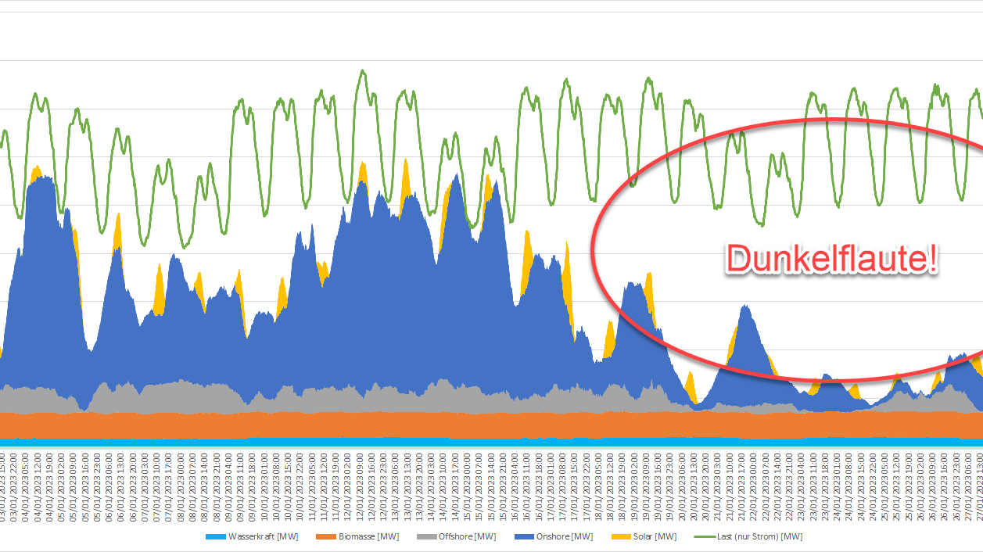
Automated Identification of “Dunkelflaute” Events: A Convolutional Neural Network – Based Autoencoder Approach
Name: Kothapally Vinaygoud
Id : 700757217

Slide 2
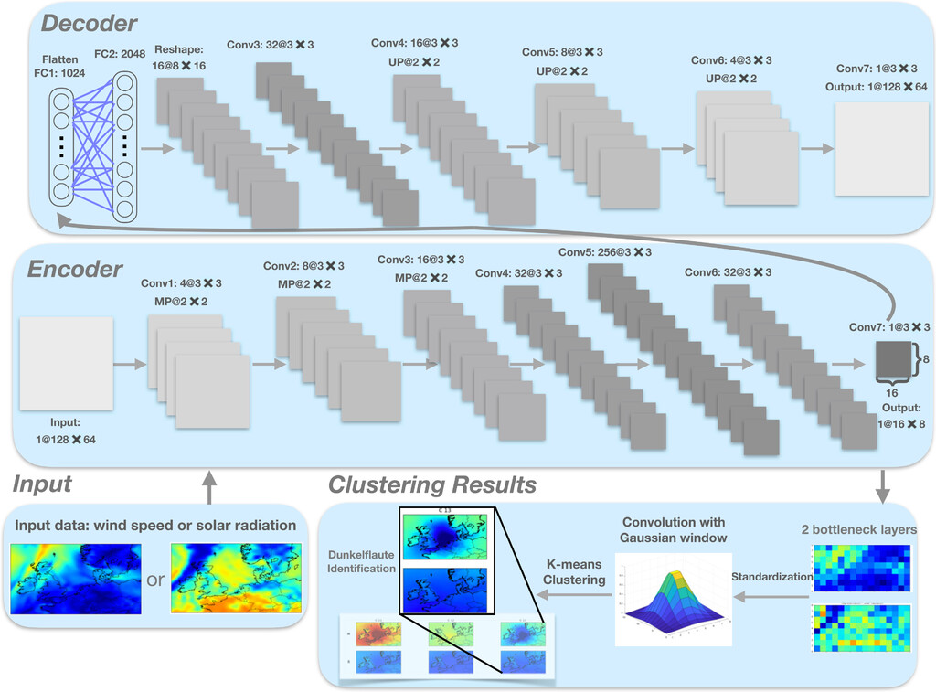

Motivation
The motivation for this research is driven by the urgent need to improve the reliability and stability of renewable energy systems in the face of variable and intermittent energy sources. By leveraging advanced machine learning techniques, the goal is to develop an effective and scalable solution for identifying and managing Dunkelflaute events, thereby enhancing the resilience, efficiency, and sustainability of the energy grid. This research aims to make a significant contribution to the field of renewable energy management and support the global transition towards a more sustainable energy future.

Slide 3
Problem statement
The increasing reliance on renewable energy sources such as wind and solar power presents significant challenges for energy grid stability and management. One major challenge is the occurrence of "Dunkelflaute" events, periods characterized by low wind speeds and overcast skies, leading to minimal renewable energy generation. These events can cause severe disruptions to energy supply, requiring effective identification and management strategies to maintain grid stability and ensure a continuous power supply.
Main Objective for problem:
To develop a robust and scalable automated system for the identification of Dunkelflaute events using a Convolutional Neural Network (CNN)–based autoencoder approach. This system aims to provide early warnings of low renewable energy generation periods, allowing grid operators to take proactive measures to mitigate the impact on energy supply and grid stability.

Slide 4
Objectives
Enhance Forecasting Accuracy: Improve the predictive accuracy of "Dunkelflaute" events by leveraging advanced machine learning techniques.
Develop a Rebust identification system: Design and implement a CNN-based autoencoder model capable of accurately identifying "Dunkelflaute" events from historical weather and energy production data.
K-Means Clustering :A clustering approach groups all the objects into some sub- sets of similar wind speed and insolation patterns.
K-Means Clustering without Using a Gaussian Kernel :The region-dependent clustering technique aims to clus- ter weather patterns with a focus on a region or country of interest.
Self-Organizing Map :SOM is a popular unsupervised machine learning approach . The SOM-based classifications have been widely used in the atmospheric science field

Slide 5

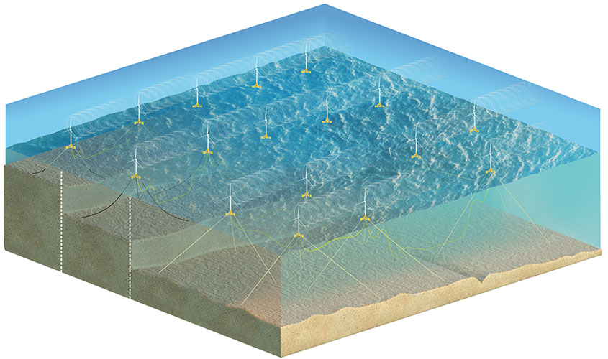
contribution
BOWEN LI : Her research interests are numerical simulation and forecast of extreme weather conditions.
SUKANTA BASU : His research interests are Atomspheric Sciences , Weather and Forecasting; Wind Energy Science
SIMON J. WATSON : Head of the wind energy section at TU DELFT(university )

Slide 6

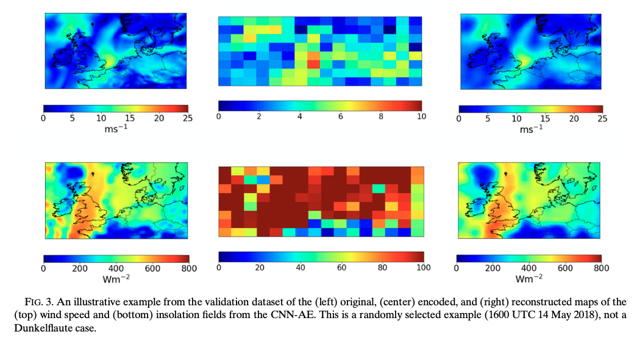
Results
A. Feature extraction : Figure 3 shows an illustrative example from the validation set of an original (left), encoded (middle), and reconstructed (right) map of the wind speed and insolation fields.
B. Weather pattern clustering : In Fig. 4, we show the clustering results of the CNN-AE patterns with the Gaussian weighting kernel centered on Belgium.
C. Identification and verification : In Table 1, we examine how frequently Dunkelflaute events actually occur for each cluster and what fraction of events are Dunkelflaute events in each cluster based on actual Belgian wind and solar power generation data for the period 2013–18. We clas-sify a particular event as a Dunkelflaute event if both wind and solar power production fall below the threshold of 20% of their respective capacities
D. Identification of Dunkelflaute for other European countries :The proposed WISRnet framework can also be applied to other countries to identify Dunkelflaute periods.

Slide 7
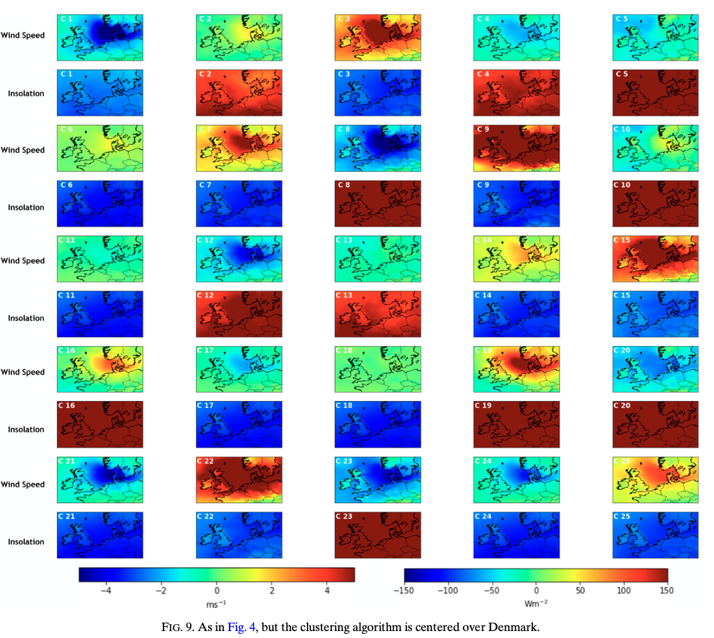
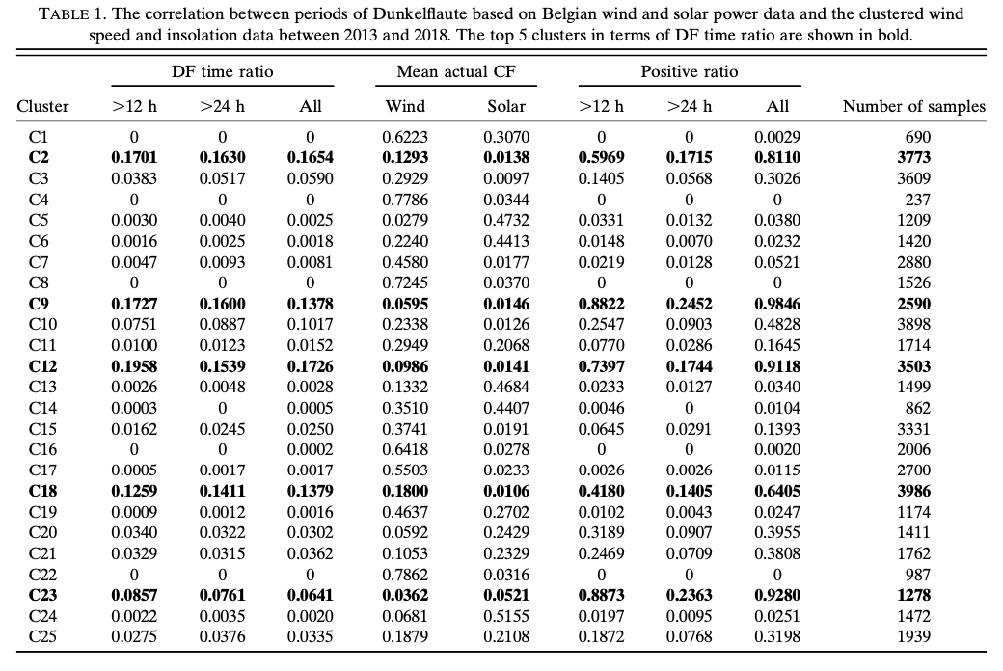
Results

Slide 8
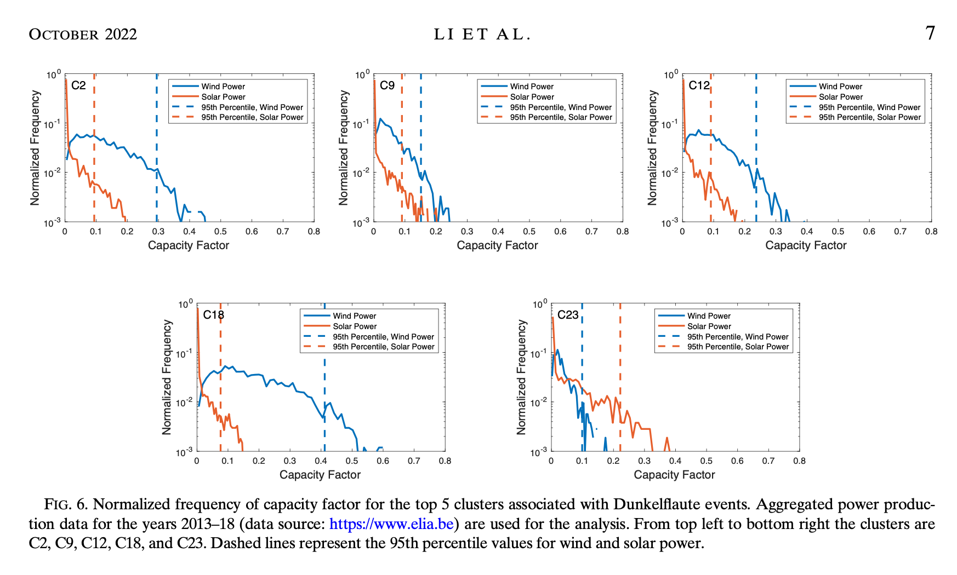

Slide 9
Critical analysis
The study employs a CNN-based autoencoder to identify "Dunkelflaute" events, periods of low wind and solar energy generation.
Strengths include automation, scalability, and advanced data handling.
However, the complexity of CNNs affects interpretability, and high-quality data is essential. Significant computational resources are required, and climate change may affect model adaptability.
Challenges include ensuring model robustness, cybersecurity, and regulatory hurdles. Continued research and collaboration are vital for addressing these challenges and maximizing the model's potential.

Slide 10
References
Abadi, M., and Coauthors, 2016: Tensorflow: A system for large-scale machine learning. 12th USENIX Symp. on Operating Systems Design and Implementation, Savannah, GA, USENIX, 265–283.
Acun ̃a-Escobar, D., M. Intriago-Pazmin ̃o, and J. Ibarra-Fiallo, 2022: Weather recognition using self-supervised deep learn- ing. SmartTech-IC 2021: Smart Technologies, Systems and Applications, F. R. Narva ́ez et al., Eds., Communications in Computer and Information Science, Vol. 1532, Springer, 161– 174, https://doi.org/10.1007/978-3-030-99170-8_12.
Agostinelli, F., M. Hoffman, P. Sadowski, and P. Baldi, 2014: Learning activation functions to improve deep neural networks. arXiv, 1412.6830v3, https://doi.org/10.48550/arXiv. 1412.6830.
Anantrasirichai, N., J. Biggs, F. Albino, P. Hill, and D. Bull, 2018: Application of machine learning to classification of volcanic deformation in routinely generated InSAR data. J. Geophys. Res. Solid Earth, 123, 6592–6606, https://doi.org/10.1029/ 2018JB015911.

